Slide 1
Amazon S3
The Backbone of Scalable Cloud Storage

Slide 2

What is Amazon S3?
Amazon Simple Storage Service (S3): A scalable object storage service by AWS.
Purpose: Store and retrieve any amount of data from anywhere.
Use Cases:
Backup and restore
Data archiving
Big data analytics
Hosting static websites

Slide 3
Core Concepts
Bucket:
A container for storing objects.
Each bucket has a unique name within the AWS ecosystem.
Supports versioning, encryption, and access controls.
Object:
Files stored in buckets, accompanied by metadata.
Each object is identified by a unique key.
Key:
A string used to identify an object within a bucket.

Slide 4
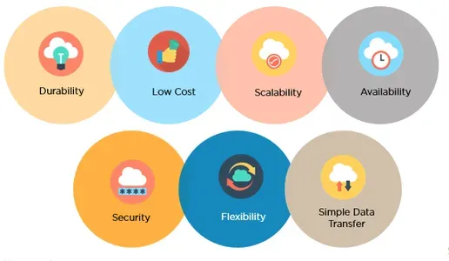
Key Features of Amazon S3
Scalability: Automatically scales storage capacity.
Durability: 99.999999999% (11 9's) durability.
Availability: High uptime and regional redundancy.
Security: Encryption and fine-grained access control.
Performance: Low-latency and high-throughput storage.

Slide 5
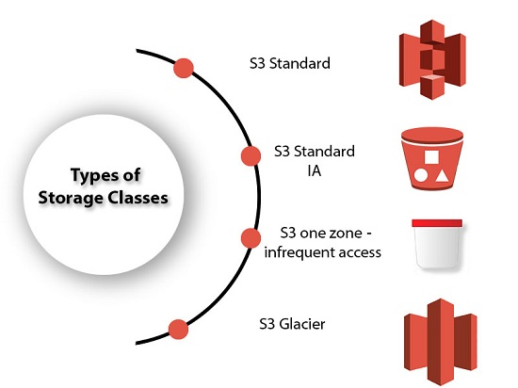
S3 Storage Classes
Standard: High durability, availability, and performance for frequently accessed data.
Standard-IA (Infrequent Access): Cheaper storage for less frequently accessed data.
One Zone-IA: Cost-effective for infrequently accessed data stored in a single Availability Zone.
Glacier: Low-cost storage for long-term archival.
Intelligent-Tiering: Automatically moves data between cost-effective tiers.

Slide 6
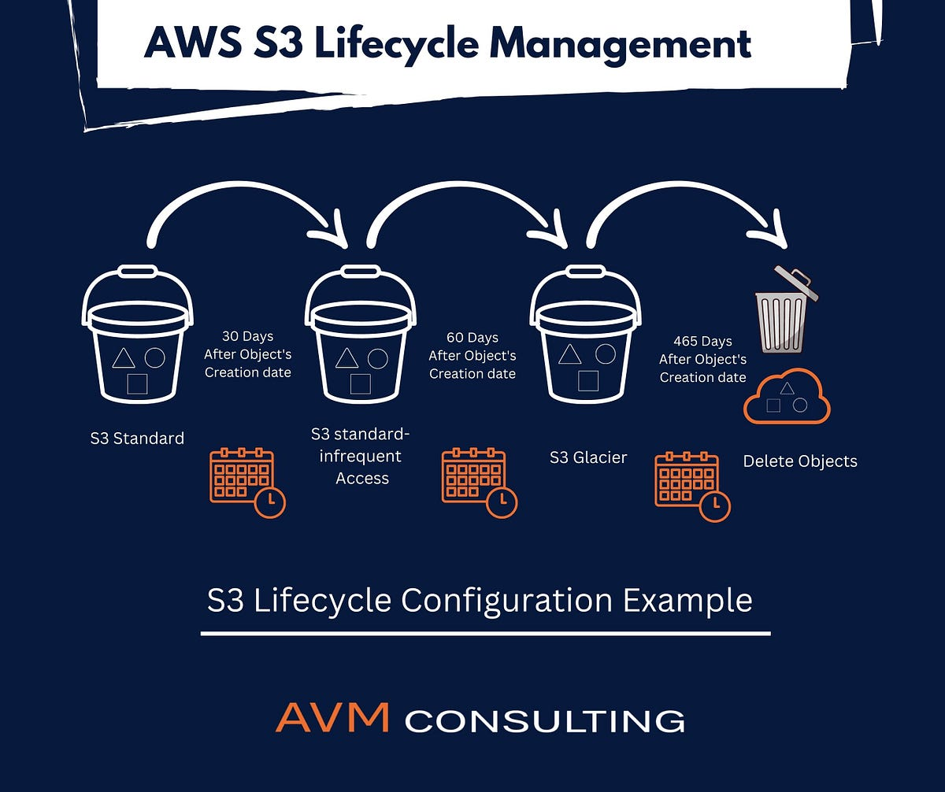

Slide 7
How Amazon S3 Works
Create a Bucket:
Use the AWS Console, CLI, or SDK to create a bucket.
Name it uniquely within the AWS global namespace.
Upload Objects:
Files are stored in the bucket as objects with metadata.
Access Objects:
Retrieve files using REST API, SDKs, or pre-signed URLs.

Slide 8
Benefits of Amazon S3
Reliability: Built on AWS global infrastructure.
Cost-Effectiveness: Pay only for storage used; no upfront costs.
Flexibility: Supports a wide range of use cases, from backups to web hosting.
Ease of Use: Easy to manage and configure with AWS tools.

Slide 9
Security Features
Data Encryption:
Server-Side Encryption (SSE): Encrypts data at rest.
Client-Side Encryption: Data encrypted before uploading.
Access Management:
IAM Policies: Control who can access what.
Bucket Policies: Define access rules for buckets.
S3 Access Points: Simplify managing access to shared buckets.
Compliance:
Meets regulatory standards like GDPR, HIPAA, and PCI DSS.

Slide 10
Real-World Use Cases
Data Backup and Archival:
Reliable storage for disaster recovery.
Static Website Hosting:
Cost-effective for hosting HTML, CSS, and JavaScript files.
Big Data Analytics:
Stores large datasets for tools like AWS Athena or Amazon EMR.
Media Storage:
Host and distribute video, images, and other media files globally.

Slide 11
Cost and Pricing Model
Storage Cost: Based on GB/month.
Data Transfer: Outbound transfer incurs costs, inbound is free.
Request Pricing:
Costs for GET, PUT, DELETE operations.
Glacier Retrieval Costs: Vary by retrieval speed (Instant, Expedited, Standard).

Slide 12
S3 Best Practices
Enable Versioning: Protect against accidental deletion.
Use Lifecycle Policies: Optimize storage costs.
Secure Your Data: Enforce encryption and IAM best practices.
Monitor Usage: Use CloudWatch for monitoring and cost tracking.

Slide 13
Summary
Amazon S3 is a foundational service for AWS cloud computing.
Key Takeaways: Scalable, durable, secure, and cost-effective storage.
Encouragement: Explore S3 by creating a free-tier AWS account.

